Slide 1

CSE 350 Digital Electronics and Pulse Techniques
NMOS NOT and NOR without load CMOS Logic Circuit Design
Course Instructor: Shomen Kundu (SDU)
Mail: shomen.kundu@bracu.ac.bd
Desk: 4N148

Slide 2
MOS Logic family
Unipolar logic family: current conduction is done by one type of charge carriers.
e.g. electron or hole

Slide 3
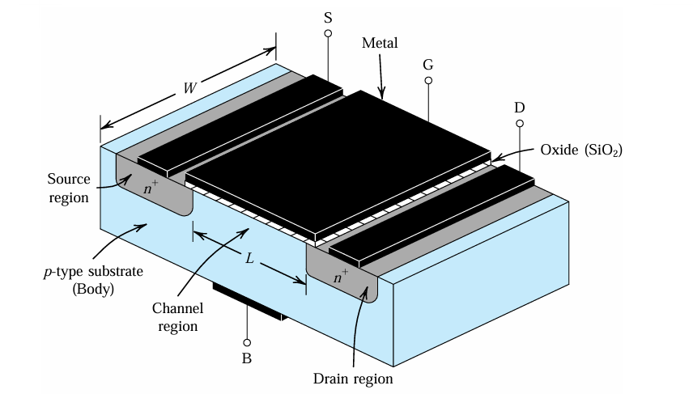
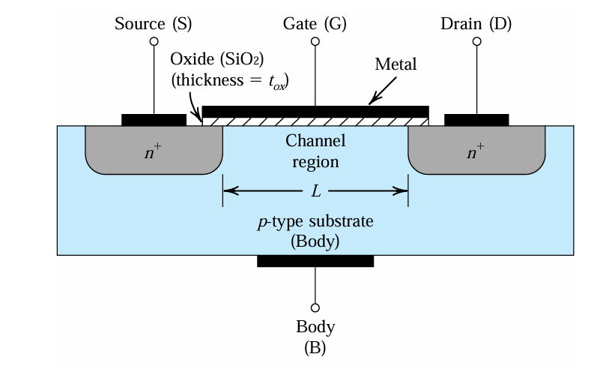
Basic Internal Structure
If some MOSFET is fabricated identically then source and body might be shorted.

Slide 4
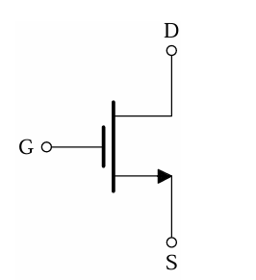
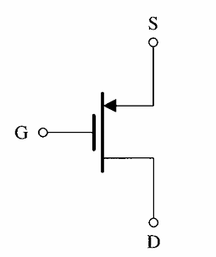
Circuit Symbol
N-MOS
p-MOS

Slide 5
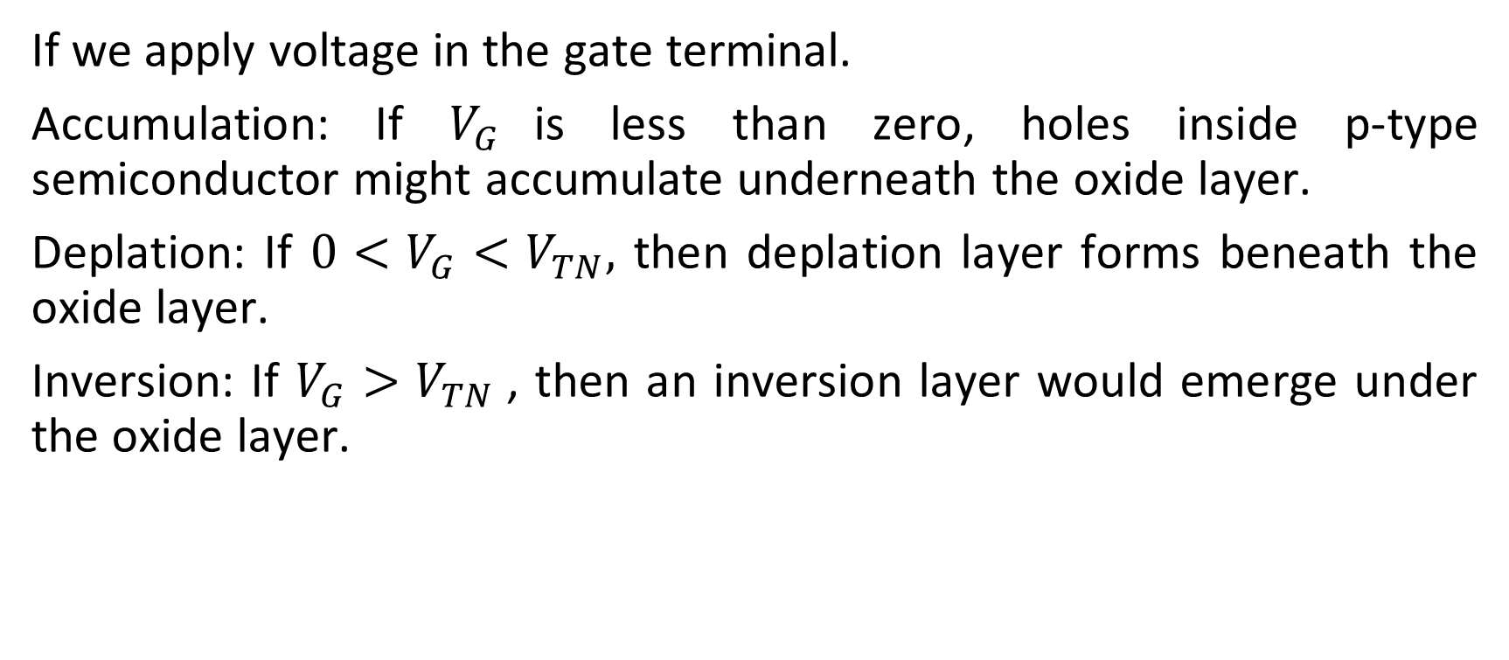
Basic Operation
If we apply voltage in the gate terminal.
Accumulation: If $V_{G}$is less than zero, holes inside p-type semiconductor might accumulate underneath the oxide layer.
Deplation: If $0<V_{G}<V_{TN},$ then deplation layer forms beneath the oxide layer.
Inversion: If $V_{G}>V_{TN}$, then an inversion layer would emerge under the oxide layer.

Slide 6
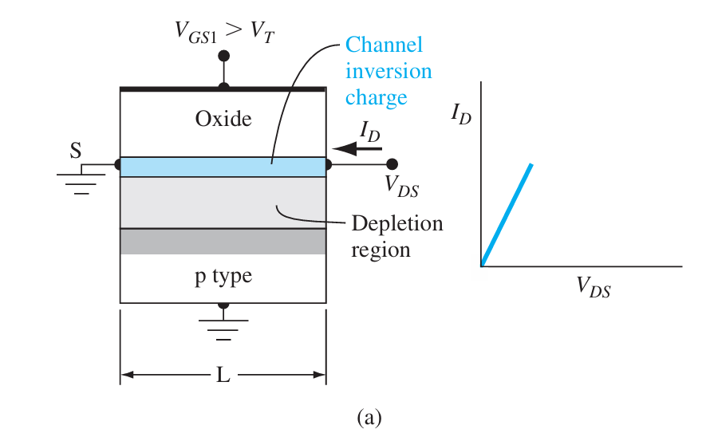
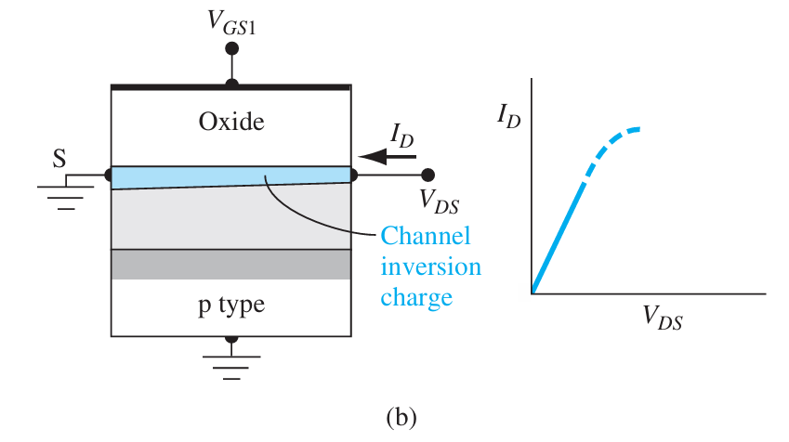



Basic Operation
Now if we apply $V_{GS}>V_{TN}$, a channel forms.
NMOS for small $V_{DS}$
NMOS for increased $V_{DS}$

Slide 7
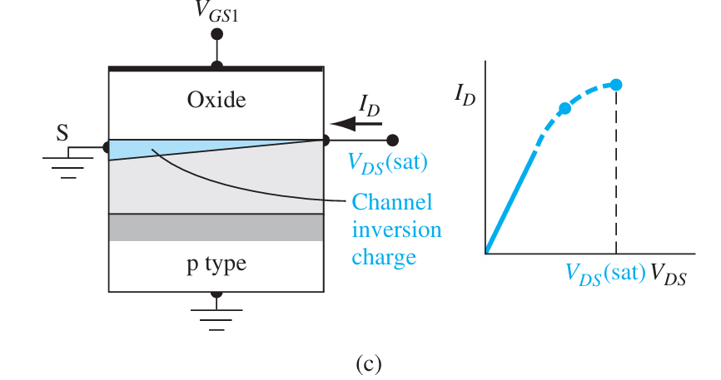
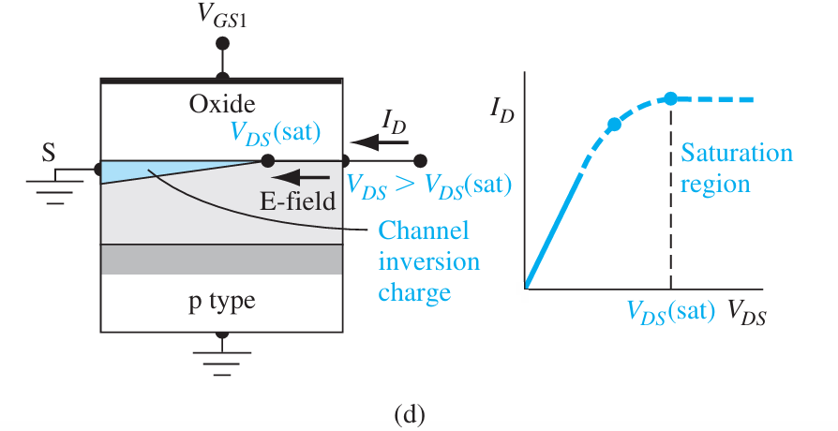


Basic Operation
Now if we apply $V_{GS}>V_{TN}$, a channel forms.
Edge of Saturation, $V_{DS}=V_{GS} −V_{TN}$
Saturation, $V_{DS}>V_{GS} −V_{TN}$

Slide 8
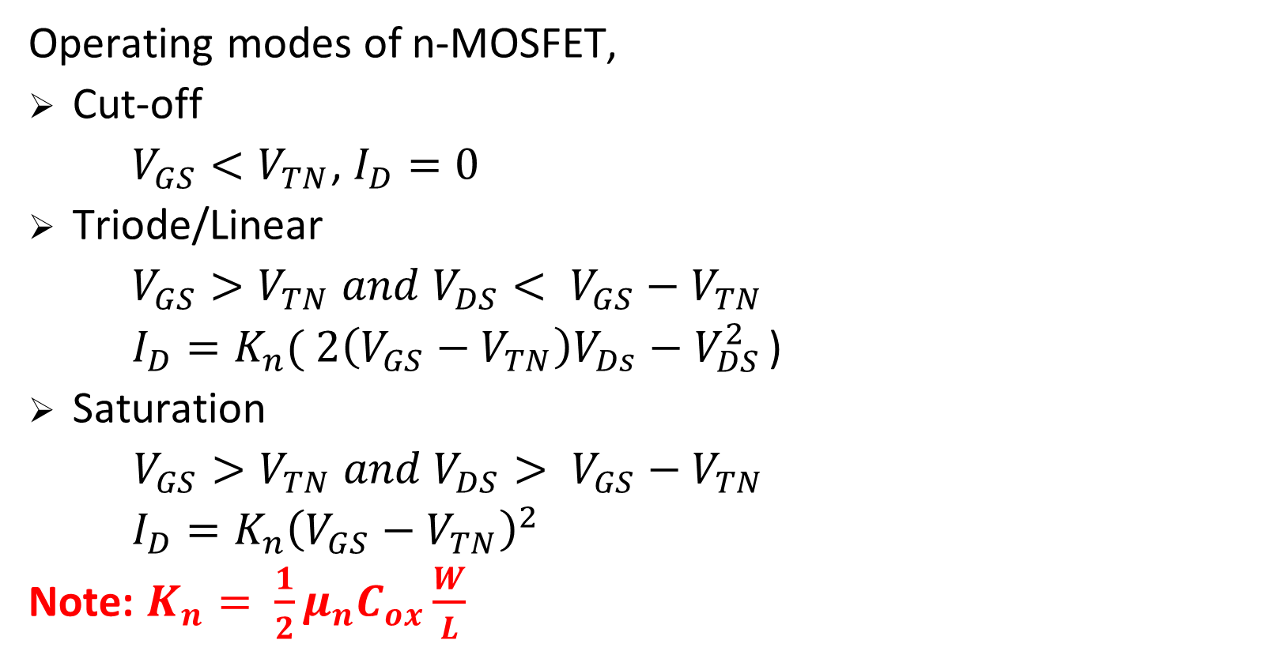
Operating modes of MOSFET
Operating modes of n-MOSFET,
Cut-off
$V_{GS}<V_{TN}$, $I_{D}=0$
Triode/Linear
$V_{GS}>V_{TN} and {V_{DS}< V}_{GS}−V_{TN}$
$I_{D}=K_{n}( 2\left(V_{GS}−V_{TN}\right)V_{Ds}−V_{DS}^{2}$ )
Saturation
$V_{GS}>V_{TN} and {V_{DS}> V}_{GS}−V_{TN}$
$I_{D}=K_{n}{\left(V_{GS}−V_{TN}\right)}^{2}$
Note: $K_{n}= {\frac{1}{2}μ}_{n}C_{ox}\frac{W}{L}$

Slide 9
N-MOS Logic
Pull up network: High resistance
Pull down network: n-MOS
Logic design techniques:
Series n-MOS indicates AND
Parallel n-MOS indicates OR
Overall n-MOS logic is inverted

Slide 10
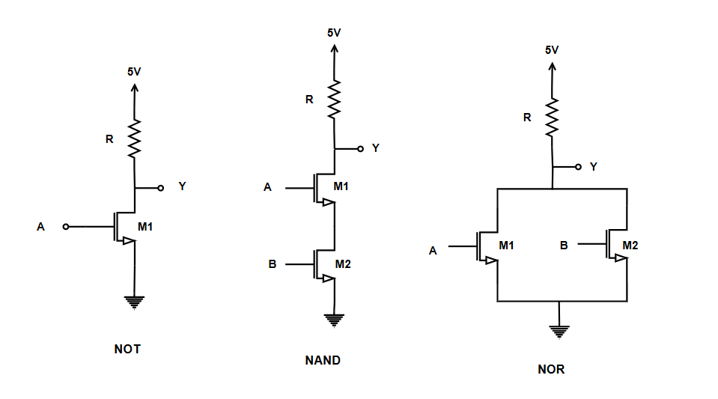
N-MOS Logic

Slide 11
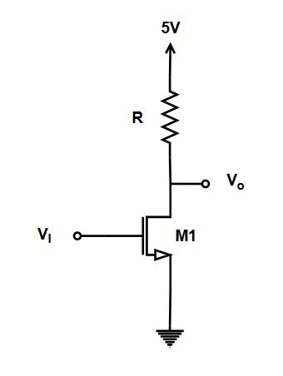

N-MOS NOT gate/Inverter
Find the output of the inverter for the input voltage 5 V and 1.5 V. Given $V_{TN}=0.5 V, R=20 k,$
$$V_{DD}=5V, {K_{n}=\frac{1}{2}μ}_{n}C_{ox}\frac{W}{L}=0.3 mA/V^{2}$$

Slide 12
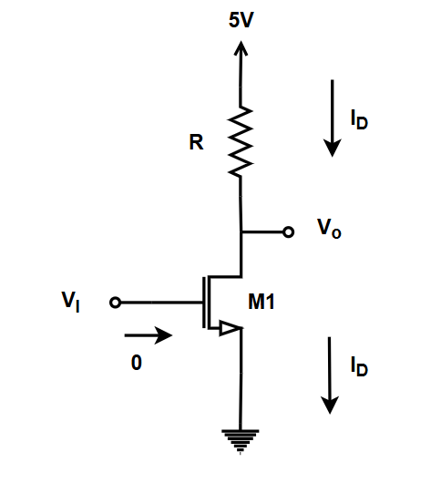
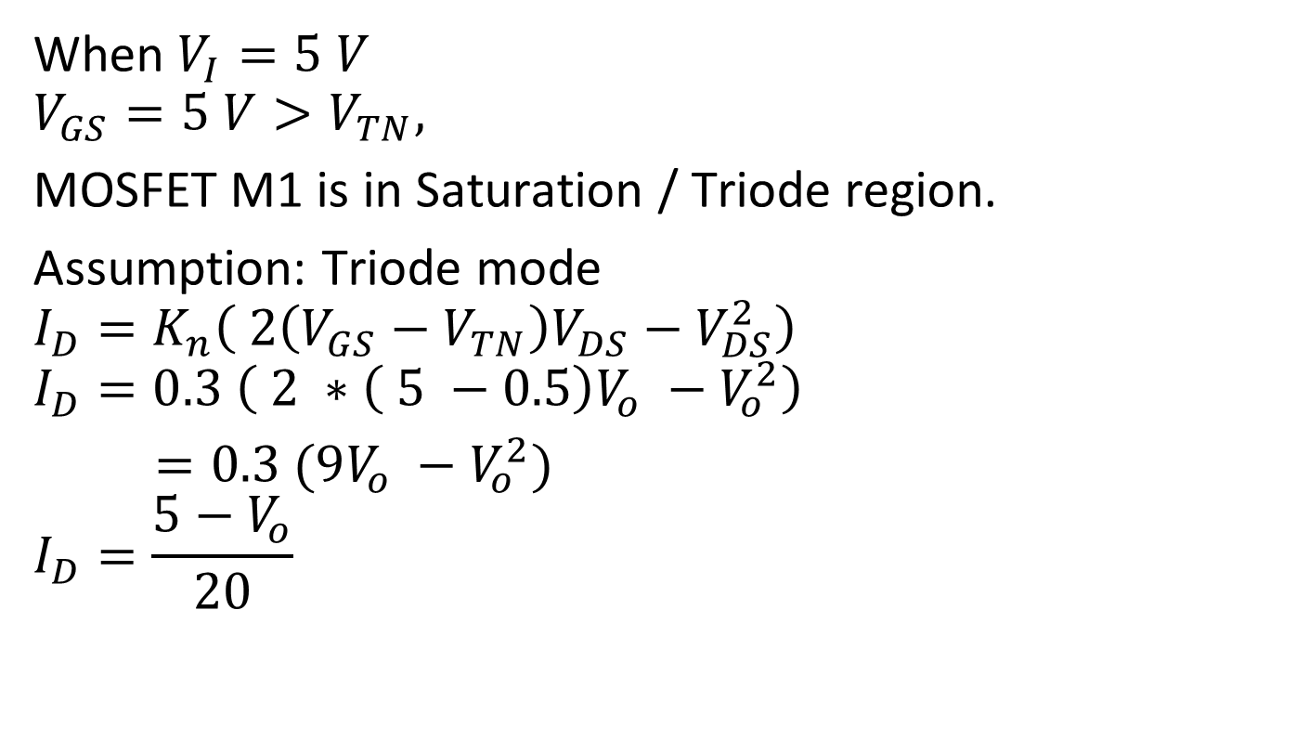
N-MOS NOT gate/Inverter
When $V_{I}=5 V$
$$V_{GS}=5 V>V_{TN},$$
MOSFET M1 is in Saturation / Triode region.
Assumption: Triode mode
$$I_{D}=K_{n}\left( 2\left(V_{GS}−V_{TN}\right)V_{DS}−V_{DS}^{2}\right)$$
$$I_{D}=0.3 \left( 2 ∗\left( 5 −0.5\right)V_{o} −V_{o}^{2}\right)$$
$=0.3 (9V_{o} −V_{o}^{2})$
$$I_{D}=\frac{5−V_{o}}{20}$$

Slide 13
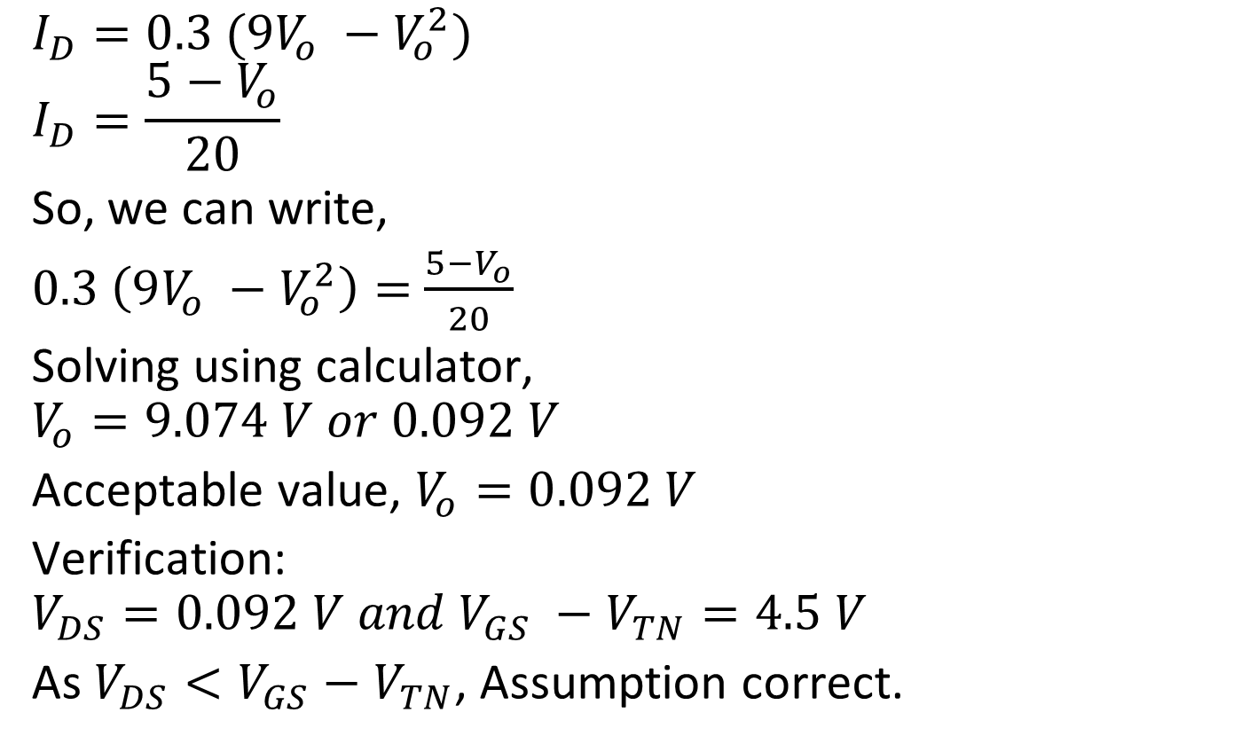
N-MOS NOT gate/Inverter
$$I_{D}=0.3 (9V_{o} −V_{o}^{2})$$
$$I_{D}=\frac{5−V_{o}}{20}$$
So, we can write,
$0.3 \left(9V_{o} −V_{o}^{2}\right)=$ $\frac{5−V_{o}}{20}$
Solving using calculator,
$$V_{o}=9.074 V or 0.092 V$$
Acceptable value, $V_{o}=0.092 V$
Verification:
$$V_{DS}=0.092 V and V_{GS} −V_{TN}=4.5 V$$
As $V_{DS}<V_{GS}−V_{TN}$, Assumption correct.

Slide 14
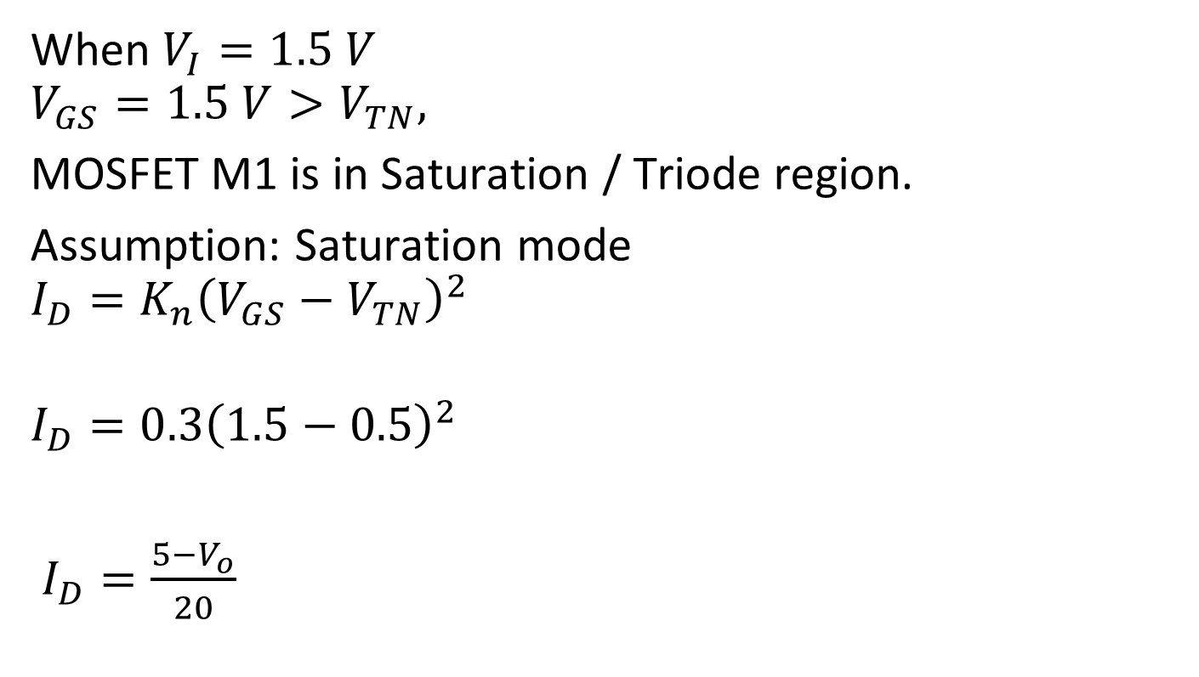
N-MOS NOT gate/Inverter
When $V_{I}=1.5 V$
$$V_{GS}=1.5 V>V_{TN},$$
MOSFET M1 is in Saturation / Triode region.
Assumption: Saturation mode
$$I_{D}=K_{n}{\left(V_{GS}−V_{TN}\right)}^{2}$$
$$I_{D}=0.3{\left(1.5−0.5\right)}^{2}$$
$I_{D}=\frac{5−V_{o}}{20}$

Slide 15
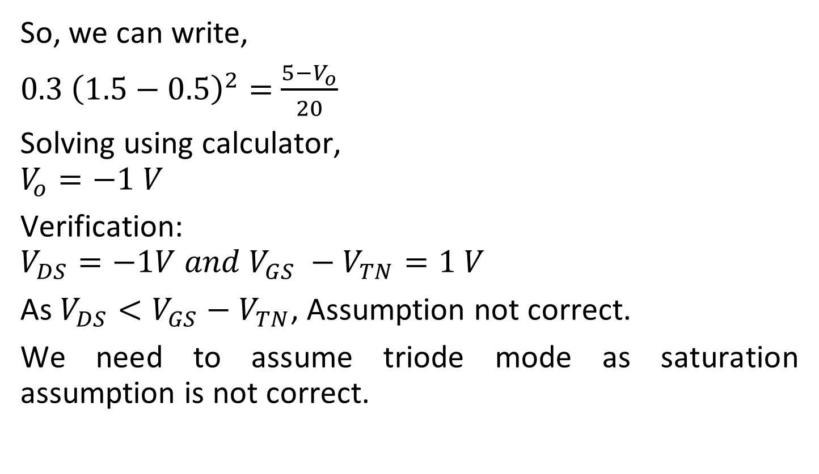
N-MOS NOT gate/Inverter
So, we can write,
$0.3 {\left(1.5−0.5\right)}^{2}=$ $\frac{5−V_{o}}{20}$
Solving using calculator,
$$V_{o}=−1 V$$
Verification:
$$V_{DS}=−1V and V_{GS} −V_{TN}=1 V$$
As $V_{DS}<V_{GS}−V_{TN}$, Assumption not correct.
We need to assume triode mode as saturation assumption is not correct.

Slide 16
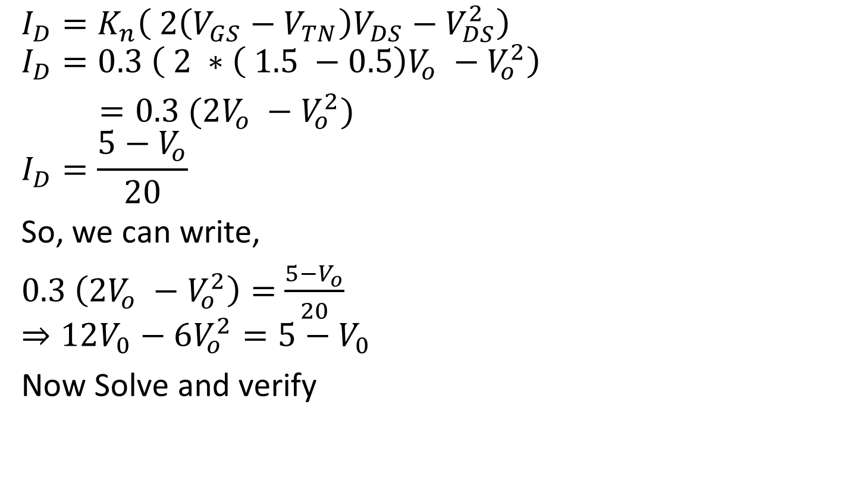
N-MOS NOT gate/Inverter
$$I_{D}=K_{n}\left( 2\left(V_{GS}−V_{TN}\right)V_{DS}−V_{DS}^{2}\right)$$
$$I_{D}=0.3 \left( 2 ∗\left( 1.5 −0.5\right)V_{o} −V_{o}^{2}\right)$$
$=0.3 (2V_{o} −V_{o}^{2})$
$$I_{D}=\frac{5−V_{o}}{20}$$
So, we can write,
$0.3 \left({2V}_{o} −V_{o}^{2}\right)=$ $\frac{5−V_{o}}{20}$
$$⇒12V_{0}−6V_{o}^{2}=5−V_{0}$$
Now Solve and verify

Slide 17
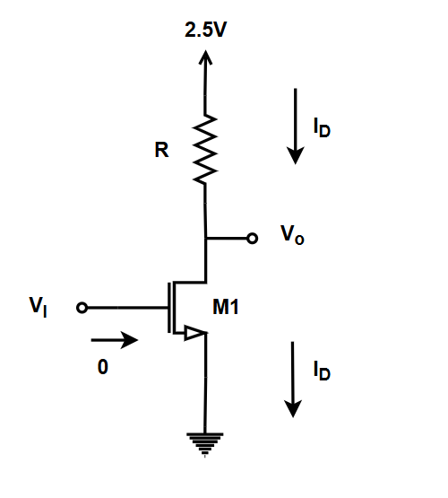

N-MOS NOT gate/Inverter
Find the transition voltage(Saturation to triode) of the inverter. Given
$$V_{TN}=0.5 V, R=20 , {K_{n}=\frac{1}{2}μ}_{n}C_{ox}\frac{W}{L}=0.3 mA/V^{2}$$

Slide 18
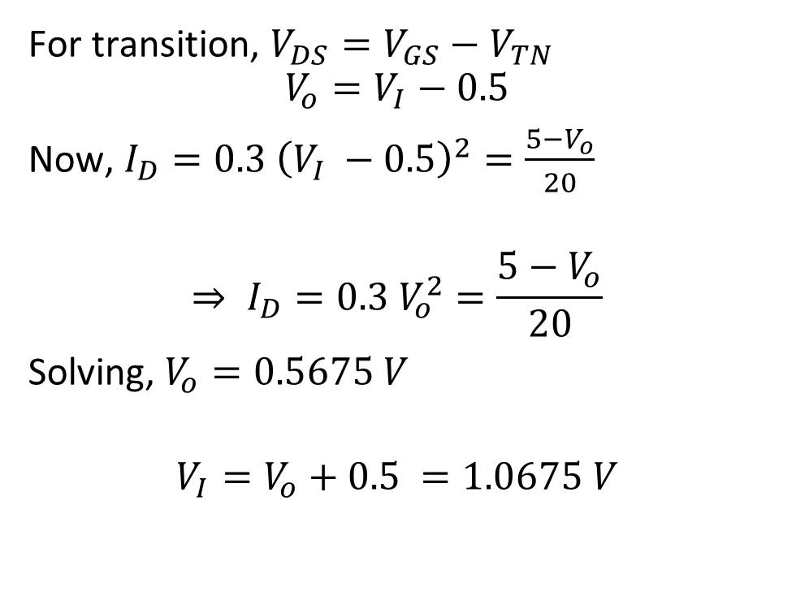
N-MOS NOT gate/Inverter
For transition, $V_{DS}=V_{GS}−V_{TN}$
$$V_{o}=V_{I}−0.5$$
Now, $I_{D}=0.3 {\left(V_{I} −0.5\right)}^{2}=\frac{5−V_{o}}{20}$
$$⇒ I_{D}=0.3 V_{o}^{2}=\frac{5−V_{o}}{20}$$
Solving, $V_{o}=0.5675 V$
$$V_{I}=V_{o}+0.5 =1.0675 V$$

Slide 19
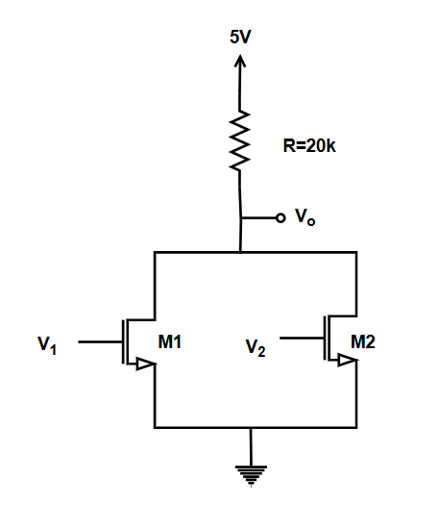
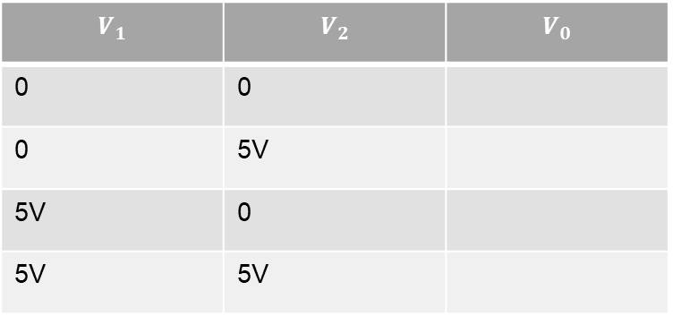
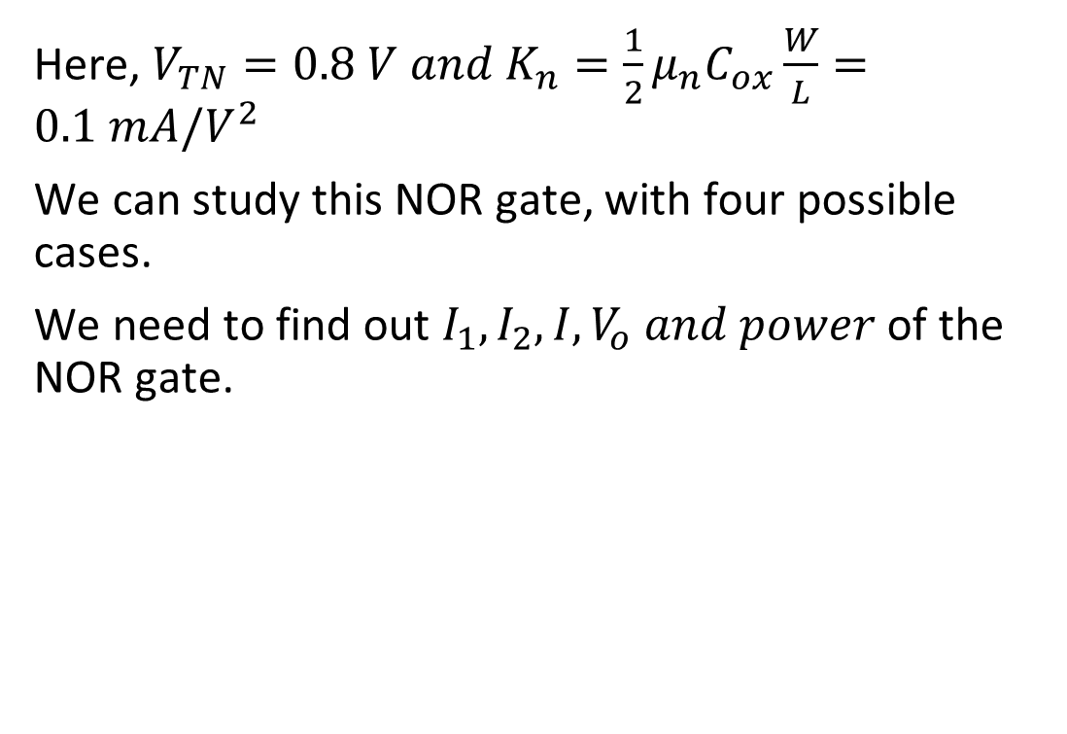
N-MOS NOR gate
Here, $V_{TN}=0.8 V and K_{n}=\frac{1}{2}μ_{n}C_{ox}\frac{W}{L}=0.1 mA/V^{2}$
We can study this NOR gate, with four possible cases.
We need to find out $I_{1}, I_{2}, I, V_{o} and power$ of the NOR gate.
$$V_{1}$$ | $$V_{2}$$ | $$V_{0}$$
0 | 0
0 | 5V
5V | 0
5V | 5V

Slide 20
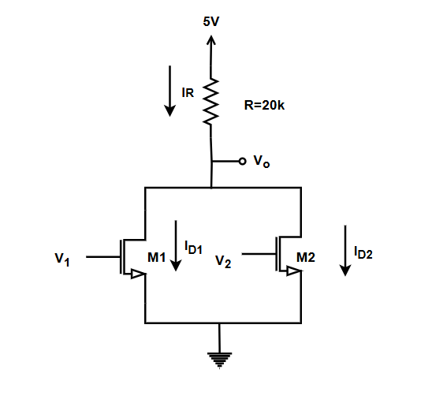
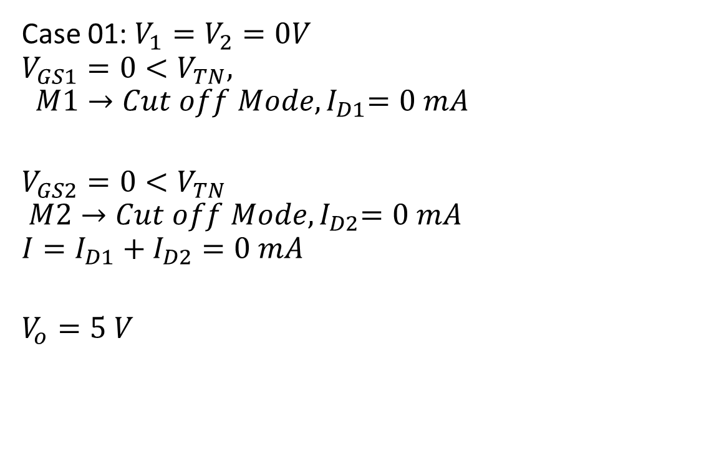
N-MOS NOR gate
Case 01: $V_{1}=V_{2}=0V$
$$V_{GS1}=0<V_{TN},$$
$${ M1→Cut off Mode, I}_{D1}=0 mA$$
$$V_{GS2}=0<V_{TN}$$
$${ M2→Cut off Mode, I}_{D2}=0 mA$$
$$I=I_{D1}+I_{D2}=0 mA$$
$$V_{o}=5 V$$

Slide 21
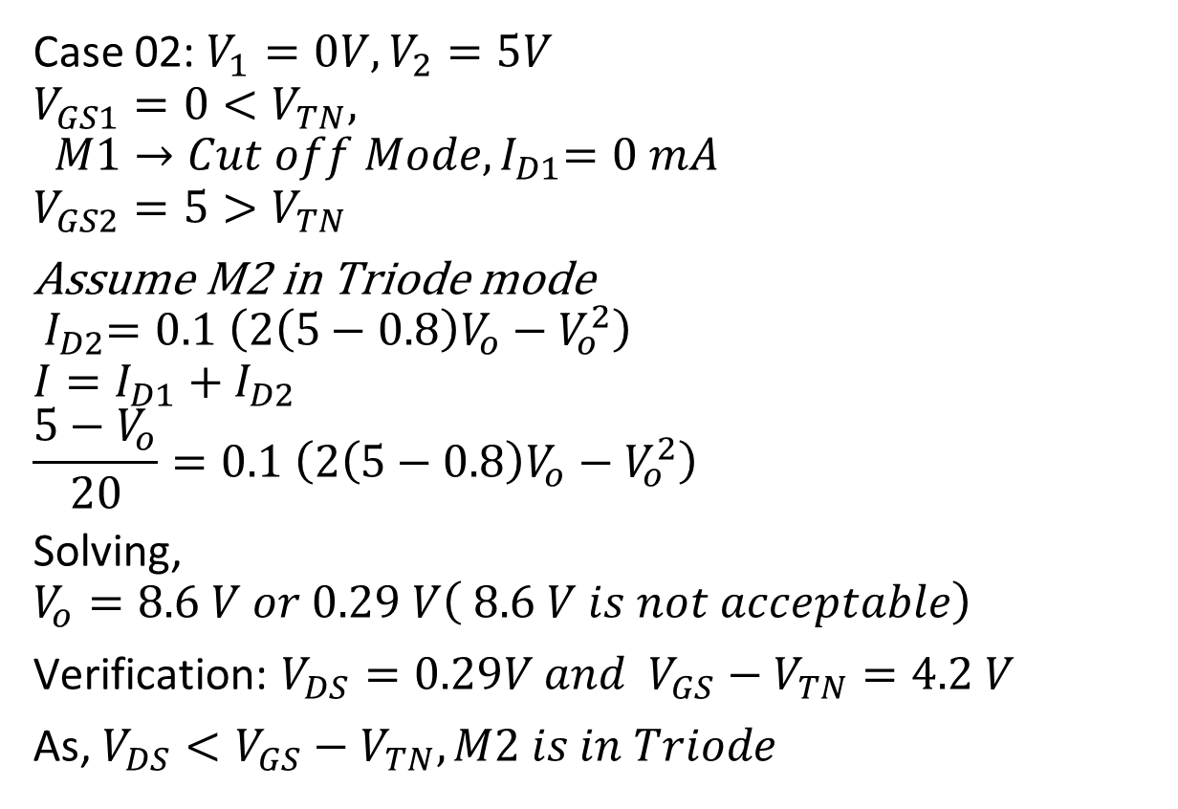
N-MOS NOR gate
Case 02: $V_{1}=0V,V_{2}=5V$
$$V_{GS1}=0<V_{TN},$$
$${ M1→Cut off Mode, I}_{D1}=0 mA$$
$$V_{GS2}=5>V_{TN}$$
Assume M2 in Triode mode
$${ I}_{D2}=0.1 \left(2\left(5−0.8\right)V_{o}−V_{o}^{2}\right)$$
$$I=I_{D1}+I_{D2}$$
$$\frac{5−V_{o}}{20}=0.1 \left(2\left(5−0.8\right)V_{o}−V_{o}^{2}\right)$$
Solving,
$$V_{o}=8.6 V or 0.29 V\left( 8.6 V is not acceptable\right)$$
Verification: $V_{DS}=0.29V and{ V}_{GS}−V_{TN}=4.2 V$
As, $V_{DS}<V_{GS}−V_{TN}, M2 is in Triode$

Slide 22

N-MOS NOR gate
Case 03: $V_{1}=5 V, V_{2}=0V$
Similar to case 2,
$${⇒V}_{o}=0.29 V$$

Slide 23
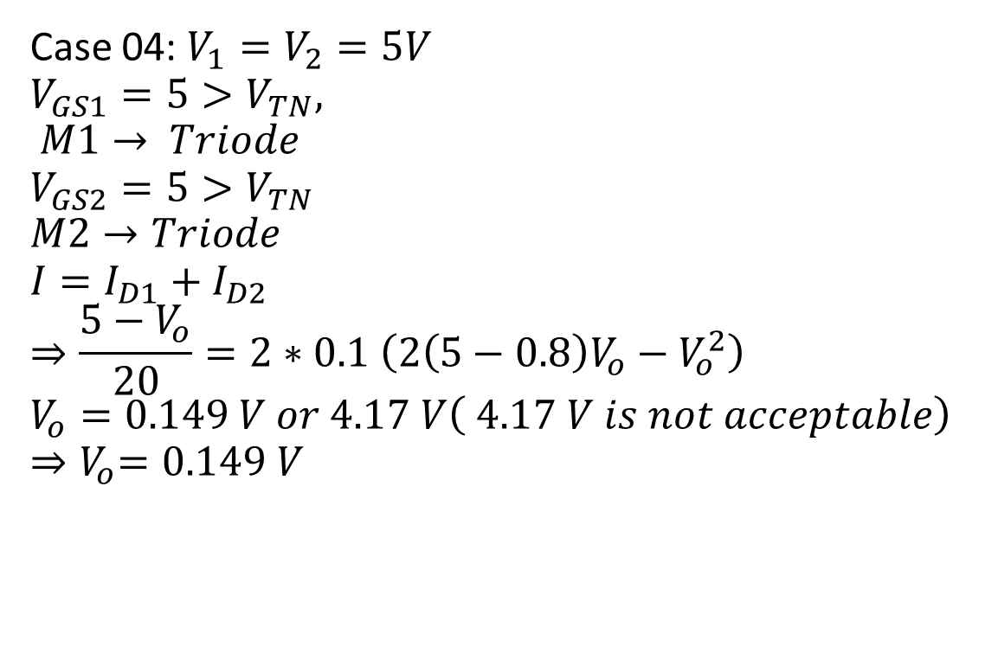
N-MOS NOR gate
Case 04: $V_{1}=V_{2}=5V$
$$V_{GS1}=5>V_{TN},$$
$$M1→ Triode$$
$$V_{GS2}=5>V_{TN}$$
$$M2→Triode$$
$$I=I_{D1}+I_{D2}$$
$$⇒\frac{5−V_{o}}{20}=2∗0.1 \left(2\left(5−0.8\right)V_{o}−V_{o}^{2}\right)$$
$$V_{o}=0.149 V or 4.17 V\left( 4.17 V is not acceptable\right)$$
$${⇒V}_{o}=0.149 V$$

Slide 24

Exercise:
For the Given NMOS find the power for all possible input cases. Also find it’s average power.
Given: $K_{n}=\frac{1}{2}μ_{n}C_{ox}\frac{W}{L}=100\frac{μA}{V^{2}}, V_{TN}=1 V. Logic High=5 V and Logic Low=0V$

Slide 25
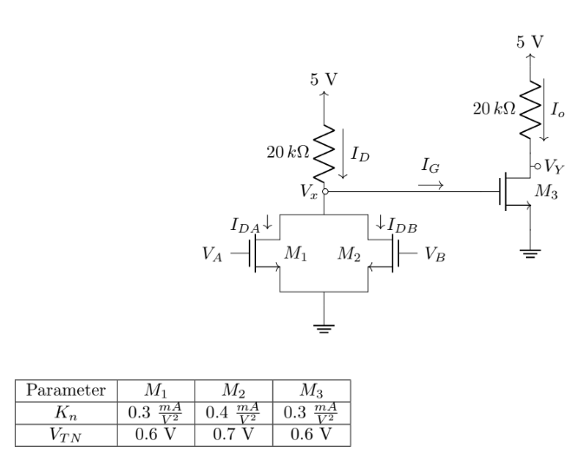

Exercise:
From the above figure, determine the currents $I_{D}, I_{DA}, I_{DB}, I_{o}, V_{x}$ and $V_{Y}$ for the cases-
Both inputs are high and both inputs are low. Also find the power dissipation of the whole circuit.

Slide 26
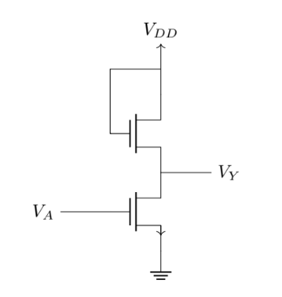
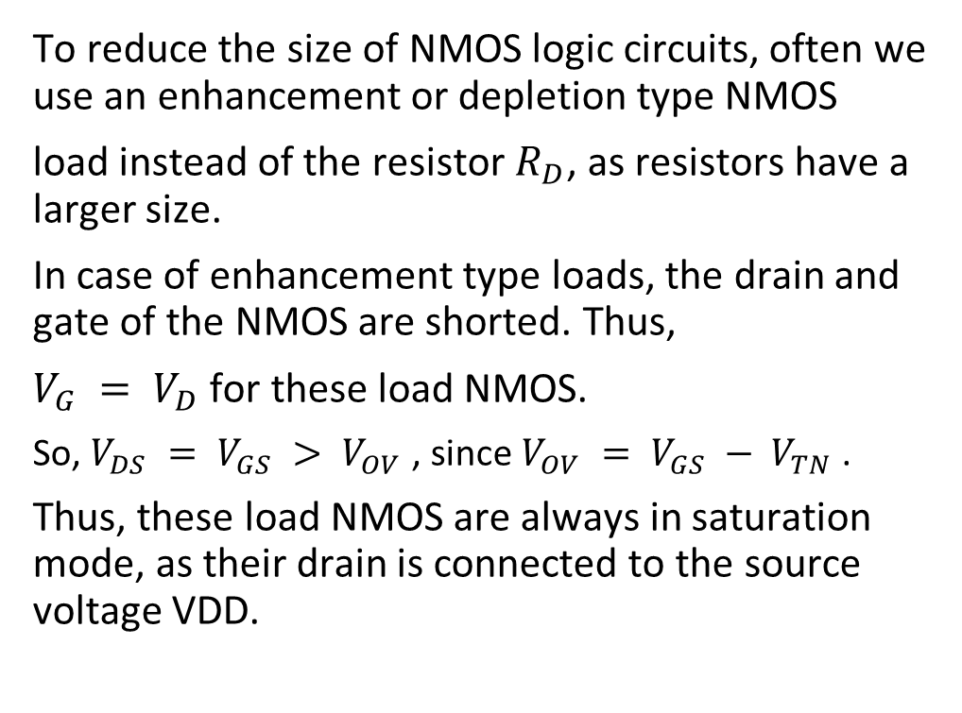
Enhancement & Depletion Type Loads
To reduce the size of NMOS logic circuits, often we use an enhancement or depletion type NMOS
load instead of the resistor $R_{D}$, as resistors have a larger size.
In case of enhancement type loads, the drain and gate of the NMOS are shorted. Thus,
$V_{G} = V_{D}$for these load NMOS.
So, $V_{DS} = V_{GS} > V_{OV}$, since $V_{OV} = V_{GS} − V_{TN}$.
Thus, these load NMOS are always in saturation mode, as their drain is connected to the source voltage VDD.

Slide 27
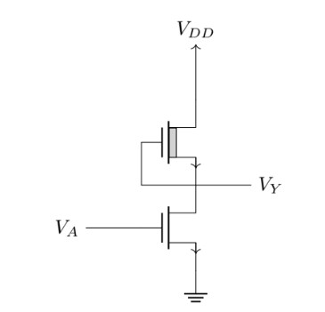

Enhancement & Depletion Type Loads
The depletion type loads are just another NMOS connected in replacement of $R_{D}$.
Just the fact that they are of depletion type means their $V_{TN} < 0$. Since they do not need any gate voltage to turn on, $V_{GS}$ can be made 0, by shorting their gate with their source.

Slide 28
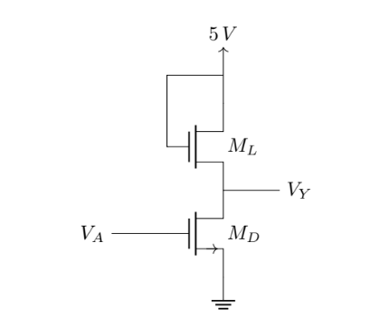

Enhancement Type Loads Example
Parameters for the driver $M_{D}, V_{TND} = 1 V ,$
$K_{nD} = 50μA/V^{2}$. Parameters for the load, $ML,V_{TNL} = 1 V , K_{nL} = 10μA/V^{2}$. Determine the output voltage and the current for both high and low input cases.

Slide 29
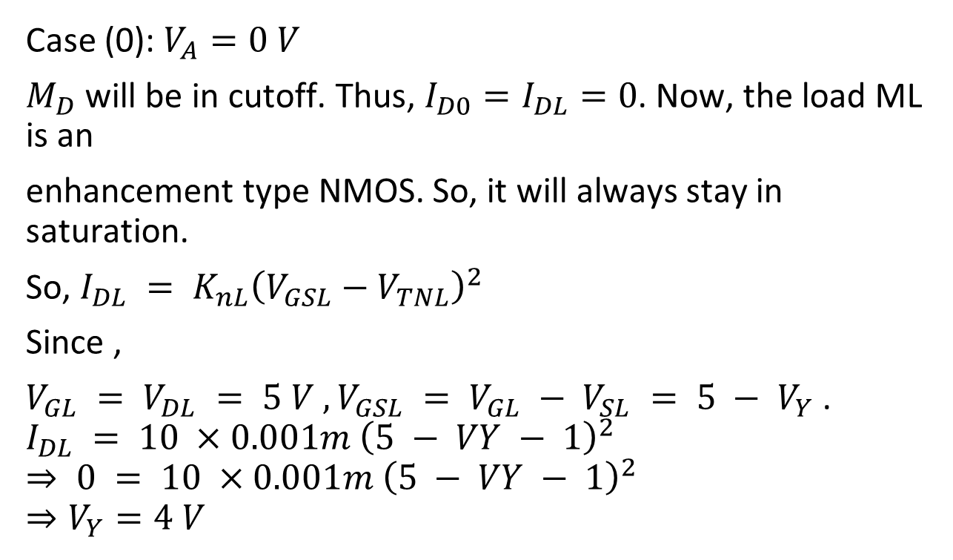
Enhancement Type Loads Example
Case (0): $V_{A}=0 V$
$M_{D}$ will be in cutoff. Thus, $I_{D0}=I_{DL}=0$. Now, the load ML is an
enhancement type NMOS. So, it will always stay in saturation.
So, $I_{DL} = K_{nL}{\left(V_{GSL}−V_{TNL}\right)}^{2}$
Since ,
$V_{GL} = V_{DL} = 5 V , V_{GSL} = V_{GL} − V_{SL} = 5 − V_{Y}$.
$$I_{DL} = 10 ×0.001m {\left(5 − VY − 1\right)}^{2}$$
$$⇒ 0 = 10 ×0.001m {\left(5 − VY − 1\right)}^{2}$$
$$⇒V_{Y}=4 V$$

Slide 30
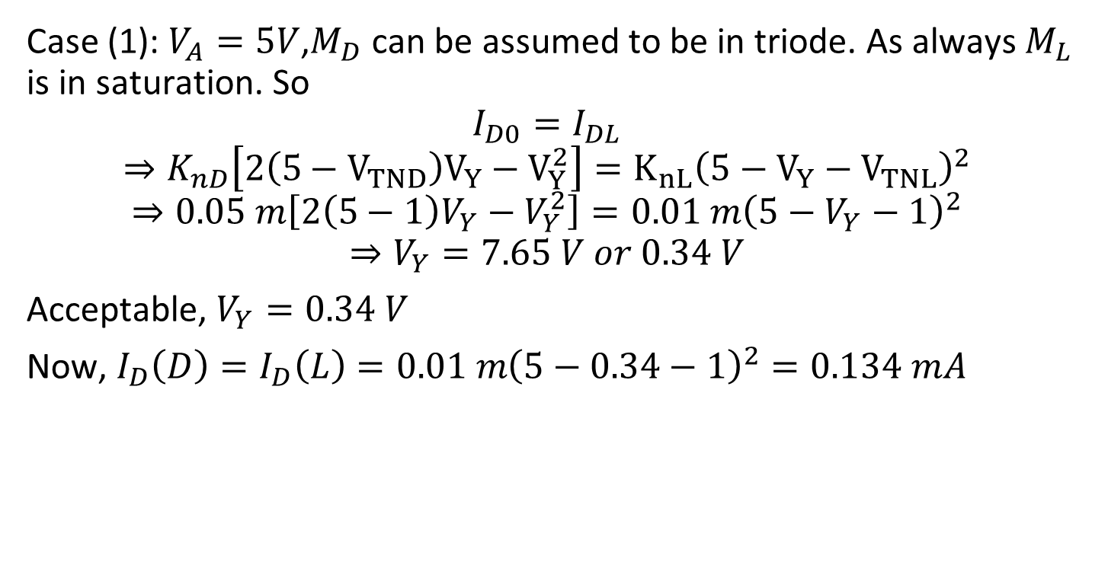
Enhancement Type Loads Example
Case (1): $V_{A}=5V$,$M_{D}$ can be assumed to be in triode. As always $M_{L}$ is in saturation. So
$$I_{D0}=I_{DL}$$
$$⇒K_{nD}\left[2\left(5−V_{TND}\right)V_{Y}−V_{Y}^{2}\right]=K_{nL}{\left(5−V_{Y}−{ V}_{TNL}\right)}^{2}$$
$$⇒0.05 m\left[2\left(5−1\right)V_{Y}−V_{Y}^{2}\right]=0.01 m{\left(5−V_{Y}−1\right)}^{2}$$
$$⇒V_{Y}=7.65 V or 0.34 V$$
Acceptable, $V_{Y}=0.34 V$
Now, $I_{D}\left(D\right)=I_{D}\left(L\right)=0.01{ m\left(5−0.34−1\right)}^{2}=0.134 mA$

Slide 31
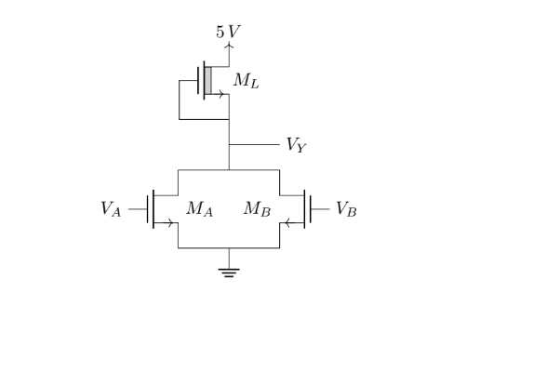
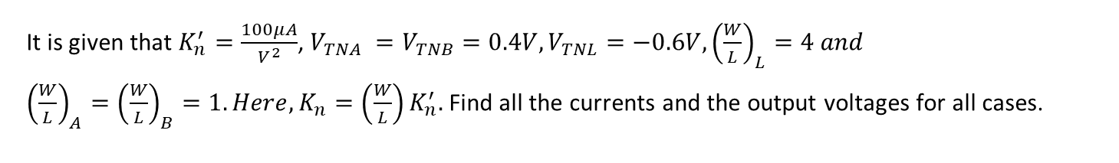
Depletion type Type Loads Example
It is given that $K_{n}^{′}=\frac{100μA}{V^{2}}$, $V_{TNA} =V_{TNB}=0.4V, V_{TNL}=−0.6V, {\left(\frac{W}{L}\right)}_{L}=4 and$
${\left(\frac{W}{L}\right)}_{A}={\left(\frac{W}{L}\right)}_{B}=1. Here,K_{n}=\left(\frac{W}{L}\right)K_{n}^{′}.$Find all the currents and the output voltages for all cases.

Slide 32
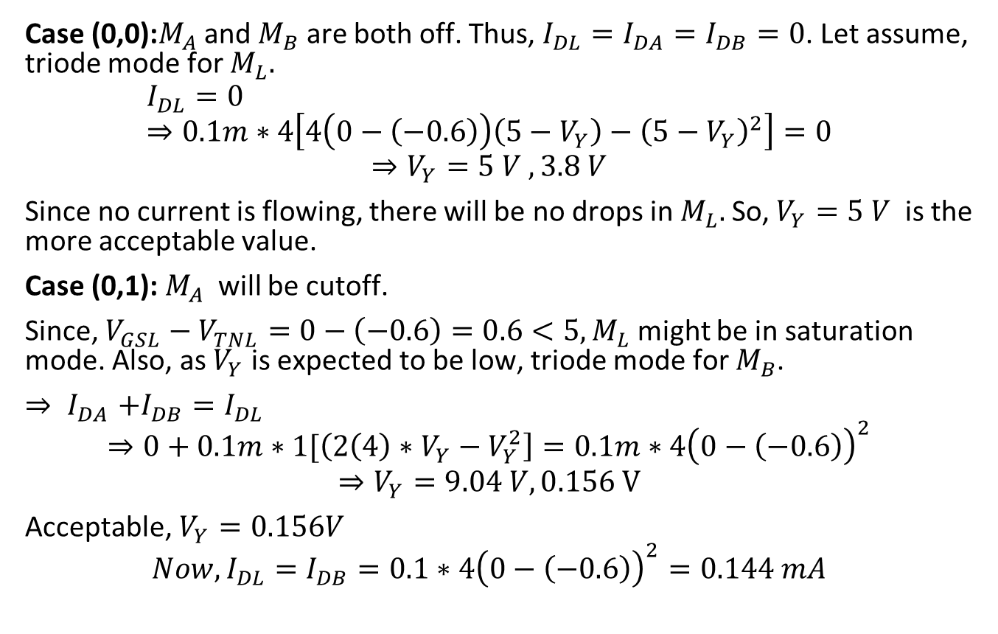
Depletion type Type Loads Example
Case (0,0):$M_{A}$ and $M_{B}$ are both off. Thus, $I_{DL}=I_{DA}=I_{DB}=0$. Let assume, triode mode for $M_{L}.$
$$I_{DL}=0 \\ ⇒0.1m∗4\left[4\left(0−\left(−0.6\right)\right)\left(5−V_{Y}\right)−{\left(5−V_{Y}\right)}^{2}\right]=0$$
$$⇒V_{Y}=5 V , 3.8 V$$
Since no current is flowing, there will be no drops in $M_{L}.$So, $V_{Y}=5 V$ is the more acceptable value.
Case (0,1): $M_{A}$ will be cutoff.
Since, $V_{GSL}−V_{TNL}=0−\left(−0.6\right)=0.6<5, M_{L}$ might be in saturation mode. Also, as $V_{Y}$ is expected to be low, triode mode for $M_{B}$.
${⇒ I}_{DA}+I_{DB}=I_{DL}$
$$⇒0+0.1m∗1[\left(2\left(4\right)∗V_{Y}−V_{Y}^{2}\right]=0.1m∗4{\left(0−\left(−0.6\right)\right)}^{2}$$
$$⇒V_{Y}=9.04 V,0.156 V$$
Acceptable, $V_{Y}=0.156V$
$$Now, I_{DL}=I_{DB}=0.1∗4{\left(0−\left(−0.6\right)\right)}^{2}=0.144 mA$$

Slide 33
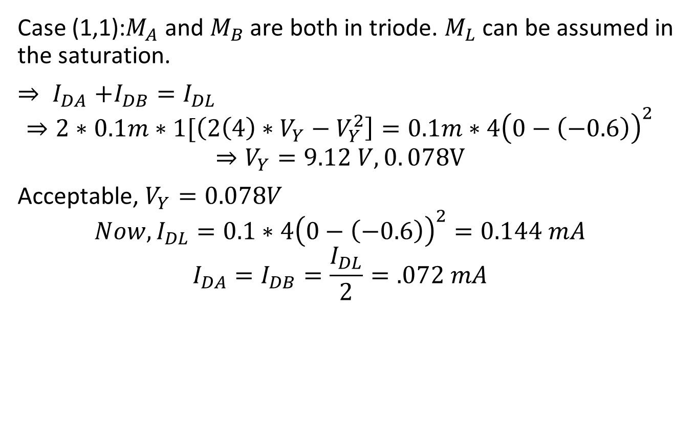
Enhancement Type Loads Example
Case (1,1):$M_{A}$ and $M_{B}$ are both in triode. $M_{L}$ can be assumed in the saturation.
${⇒ I}_{DA}+I_{DB}=I_{DL}$
$$⇒2∗0.1m∗1[\left(2\left(4\right)∗V_{Y}−V_{Y}^{2}\right]=0.1m∗4{\left(0−\left(−0.6\right)\right)}^{2}$$
$$⇒V_{Y}=9.12 V,0. 078V$$
Acceptable, $V_{Y}=0.078V$
$$Now, I_{DL}=0.1∗4{\left(0−\left(−0.6\right)\right)}^{2}=0.144 mA$$
$$I_{DA}=I_{DB}=\frac{I_{DL}}{2}=.072 mA$$

Slide 34
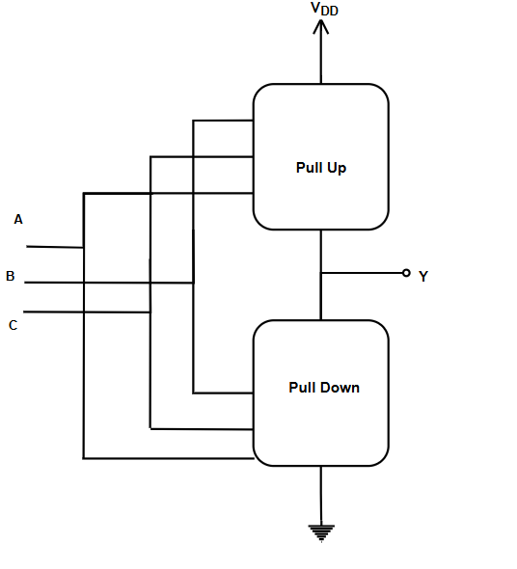
CMOS
Complementary MOS circuit design
Features,
In CMOS circuit there are two network, one is pull up and other is pull down.
At a time either pull-up or pull-down network is on.
Logic is high when pull up is on.
Logic is Low when pull down is on.
Pull down consist of N-MOS, Pull up consist of P-MOS.

Slide 35
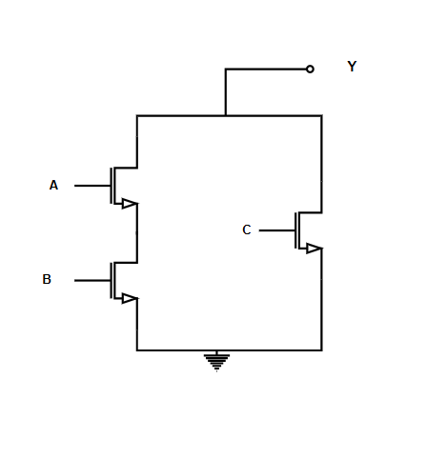

CMOS Pull Down Network Design
$$. →AND can be implemented by series of two NMOS$$
$$+ →OR can be implemented by Parallel NMOS$$
$$lower part will be connected with GND$$
$$Upper part will be connected to the Output$$
Example: $Y=\overline{AB+C}$

Slide 36
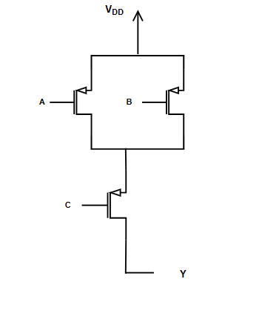

CMOS Pull Up Network Design
$$. →AND can be implemented by parallel of two PMOS$$
$$+ →OR can be implemented by Parallel NMseries of two NMOS$$
$$Lower part will be connected to the Output$$
$$Upper part will be connected with V_{DD}$$
Example: $Y=\overline{AB+C}$

Slide 37


NOT Gate
$$Y= \overline{A}$$

Slide 38



NAND Gate
$$Y= \overline{AB}$$

Slide 39



NOR Gate
$$Y= \overline{A+B}$$

Slide 40


Example:
$$Y=\overline{AB+C}$$

Slide 41


Example:
$Y=\overline{A(B+C}$)

Slide 42


Example:
$$Y=\overline{A(B+C)+DE}$$

Slide 43

Exercise:
Design a CMOS logic circuit to implement the given compound gate in Figure below. First derive
the logical expression of output Y and then design the CMOS network.

Slide 44
Exercise:
Design a CMOS circuit that will follow the given truth table.
A | B | Y
0 | 0 | 0
0 | 1 | 1
1 | 0 | 1
1 | 1 | 0

Slide 45

Exercise:
Design static CMOS circuit for the following expression,

